Slide 1

Cloud Computing.
-Public Cloud Providers.

Slide 2
Overview:
Introduction.
Concept.
Analysis.
Conclusion.
Bibliography.

Slide 3
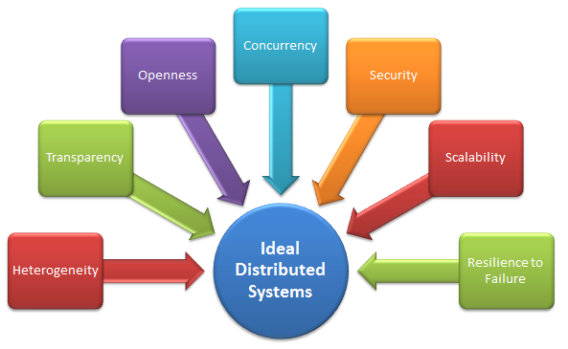
Introduction
Need Of Cloud Computing

Slide 4
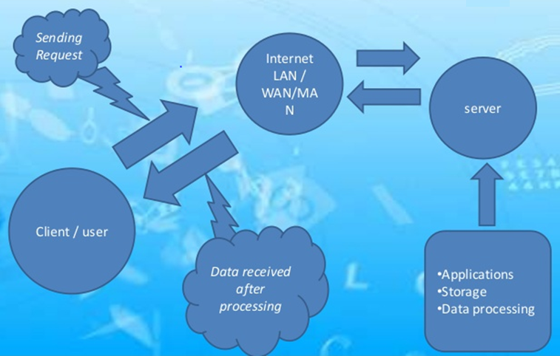
Introduction
A solution is needed so Cloud Computing is implemented as shown below.

Slide 5
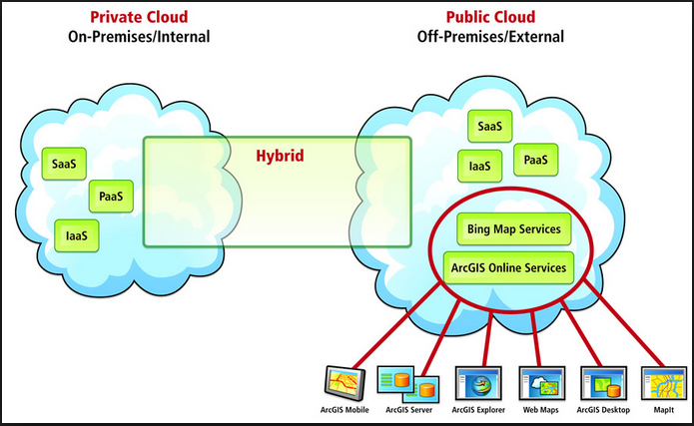
Introduction
3 segmentations in Cloud Computing.

Slide 6
Definition: Public Cloud Providers
A set of computers and computer network resources based on the standard cloud computing model, in which a service provider makes resources, such as applications and storage, available to the general public over the Internet .
Can be free or offered on a pay-per-usage model.
Applications, storage, and other resources are made available to the general public by a service provider.

Slide 7
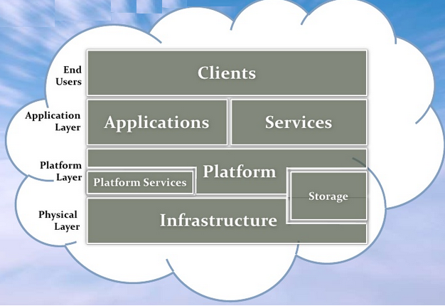
Componenets of Public cloud providers

Slide 8










Top 10 cloud providers of 2012

Slide 9
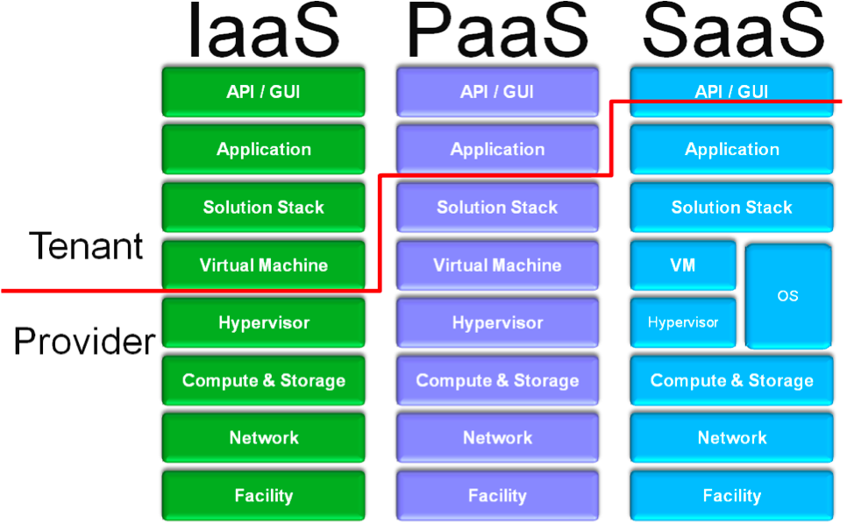
Cloud Providers Responsibility Segmentation

Slide 10
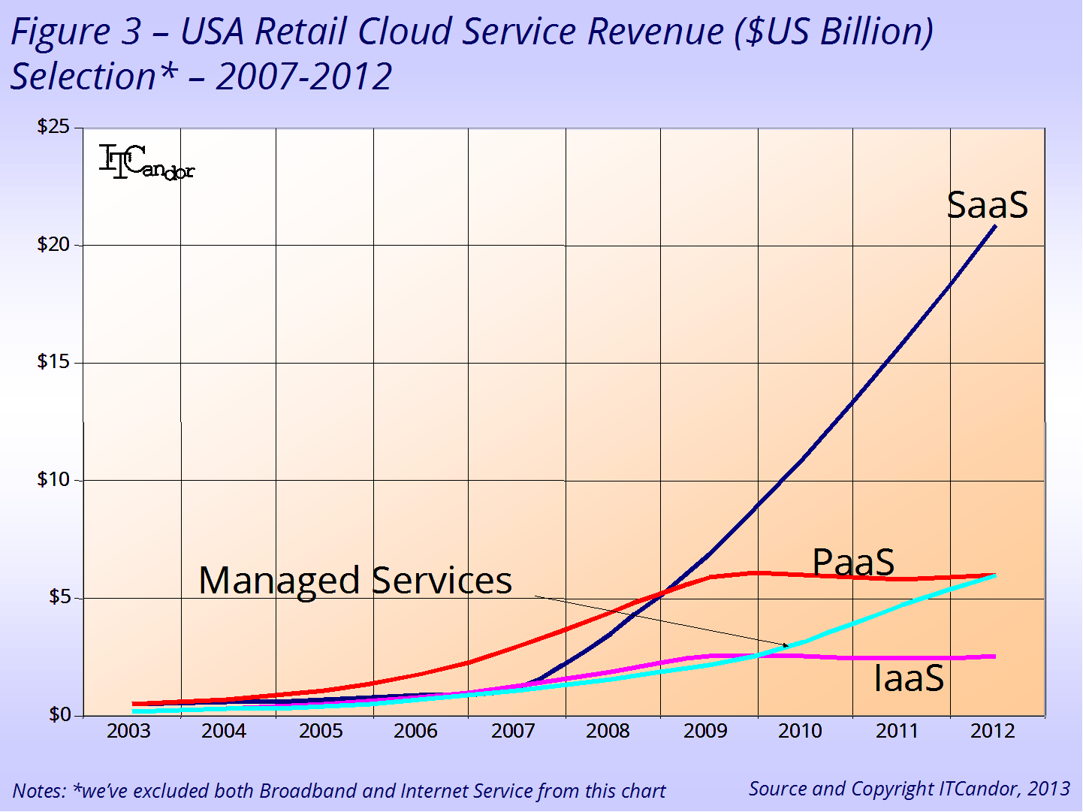
Market Trends From 2003 to 2013

Slide 11
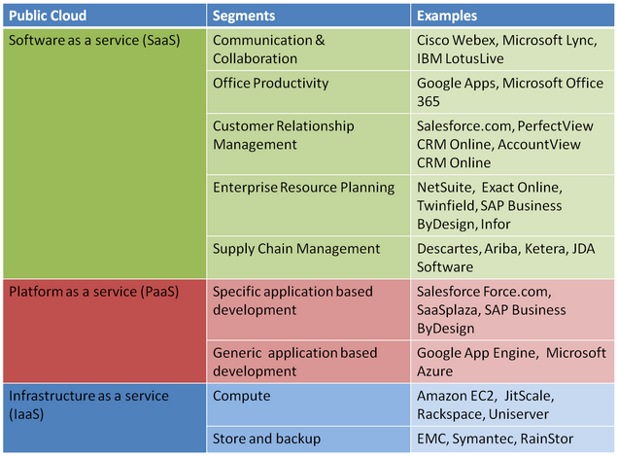
Examples of vendors providing public cloud services

Slide 12
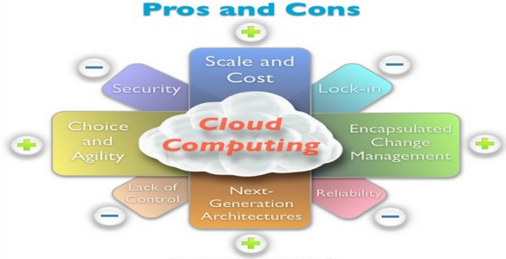
Analysis:

Slide 13
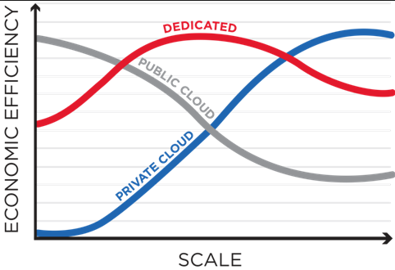
Analysis:
The picture shows the Economic efficiency v/s scale graph.

Slide 14
Risk in Public Cloud Computing
Regulatory Compliance
Data Segmentation/ User access
Recovery
Logging and investing support

Slide 15
Conclusion:
Cloud hosting services provide hosting for websites on virtual servers which pull their computing resource from extensive underlying networks of physical web servers. It follows the utility model of computing in that it is available as a service rather than a product and is therefore comparable with traditional utilities such as electricity and gas. Broadly speaking the client can tap into their service as much as they need, depending on the demands of their website, and they will only pay for what they use.

Slide 16
Conclusion:
It exists as an alternative to hosting websites on single servers (either dedicated or shared servers) and can be considered as an extension of the concept of clustered hosting where websites are hosted on multiple servers. With cloud hosting however, the network of servers that are used is vast and often pulled from different data centres in different locations.

Slide 17

Reference:
http://www.paulspatterson.com
http://searchcloudcomputing.com
http://www.datacenterjournal.com
http://www.ibm.com/cloud-computing/us/en/
http://www.zdnet.com
http://www.ijser.org/paper/Cloud-Storage-Gateway-for-Industry-Data-Base.html?gclid= CICOy9ie6bwCFfFV4godzUYA2Q
http://searchcloudprovider.techtarget.com/definition/cloud-provider
http://www.info.com/public%20cloud%20providers?cb=4&cmp=2848

Slide 18
Thank You.
Any Questions?

